Slide 1
Debugging Deep Neural Networks using SHAP
CSCI 4960
Rebecca Tsekanovskiy

Slide 2
Research Problem and Contribution
Opacity of Deep Neural Networks(DNNs) poses challenges in understanding and interpreting their decision- making processes.
How effective is Shapley Additive exPlanations in improving the transparency and interpretability of DNNs?

Slide 3
Reasons for this study
Introduction
Motivation
Deep Neural Network
Deep Convolutional Neural Network ( DCNNs)
Shapley Additive exPlanations (SHAP)
Current challenges in understanding DL models.
Reliable AI models in other fields.
Traditional debugging methods.
Notes:
AI ( machines capable of tasks of human intelligence ) – ML ( computer learning based off data_→ -> supervised learning because our dataset is labeled with breast and stomach scans
deep learning ( neural networks with layers to model complex patterns ) -> Deep neural networks → CNN ( processing data like images ) -> DCNN ( advanced CNNs with many layers )
Deep learning – refers to the specific approach -artificial neural networks with many layers to model and understand
Deep neural network – type of deep learning
ML uses neural networks with multiple layers
Mimics the way the human brain processes
Learn on a big data set , recognize patterns and make decisions
Applications: image recognition, Natural language processing, healthcare, driving, finance
DCNN – type of deep learning model designs for processing images
Black box
Not easily understood by humans
The inteneral workings
Hard to identify why a model makes errors

Slide 4
Research Method and Process
Data Collection
Model Architecture
Model Training
Data Gathering.
Medical Images.
Ensuring 66x66 pixels.
Data Splitting (70/20/10).
Input layer containing images (rgb).
Convolutional Layers.
Flatten Layer.
Dense Layers.
Dropout Layer for overfitting.
Adam Optimizer.
Loss function.
Accuracy.
Epochs.
Notes:
Breast and stomach scans – over 10k images in dataset about 5k were valid
Dataset was gotten from KAGGLE -
70/20/10 – 20 for validation /aka practicing – after training is complete used to test the model
Convolutional Layer – scans the data, highlights the important parts, summarizes the information from the dataset and keeps the important part, combining everything they learning and looking for complex patterns
Flattern Layer- once the image has been scanned and summarized, takes the 2d grid of data and flattens it into a single line
Dense Layers- takes the line of data and processes it again looking for more insight and then using SOFTMAX – determine the probability of an image belonging to each category
Dropout Layer- make sure the model is not remembering specific details about the image that is causing to get it right bc then it will not be able to generalize correctly, so ignore some data each time you train.
Adam optimizer – helps the model learn faster and more effectively and adjusts how the model learns from mistakes
Loss function – how far the model is from making the correct answer
Epoch – one epoch is one time running through the entire dataset

Slide 5
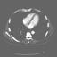
Original Image - Abdomen
Data Set
Example Image
https://github.com/apolanco3225/Medical-MNIST-Classification

Slide 6
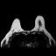
Original Image - Breast
SHAP calculations
Pixel calculation.
Different regions contribute differently.
https://github.com/apolanco3225/Medical-MNIST-Classification

Slide 7
Model Results
Model Training Results
Analysis
Epoch 1: Training accuracy: 98.37%, Validation accuracy: 100%
Epoch 2: Training accuracy: 98.60%, Validation accuracy: 100%
Epoch 3: Training accuracy: 100%, Validation accuracy: 100%
Epoch 4: Training accuracy: 100%, Validation accuracy: 100%
Epoch 5: Training accuracy: 100%, Validation accuracy: 100%
Loss was low
Easy to distinguish.

Slide 8
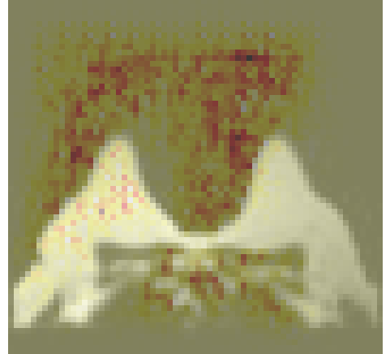
SHAP analysis
Original Image with SHAP overlay
Different regions contribute differently.
Brighter areas have a more significant impact on the model.
SHAP highlight edges around the edges
Darker regions are less important.
Symmetry.
Red highlight on the left side.
Notes:
Central part of the image is focused on- bright
The symmetry in the highlighted areas suggests the model is comparing both sides of the scan, which is crucial for accurate diagnosis in symmetrical body parts.
Different colors represent the strength of the contributions,

Slide 9
Future Steps
SHAP
Next Steps
Effectiveness of SHAP.
If model was training wrong…….
Dataset Size.
Computational efficiency and larger models.
More niche dataset.
Reach out.
Notes:
he results demonstrated how SHAP can highlight which features (or regions of the scans) significantly influence the model's predictions, aiding in the validation and improvement of the model.
sing SHAP, you also assessed whether the models were being trained correctly. This involved identifying any potential issues or biases in the training process, ensuring the models are reliable and accurate.
Training a model and in a sense hoping that its wrong
No sol in a polynomial time &&&&&&&&&&&& hard to debug bigger models
KERNEL SHAP – approximates SHAP in a less costly time

